Slide 1
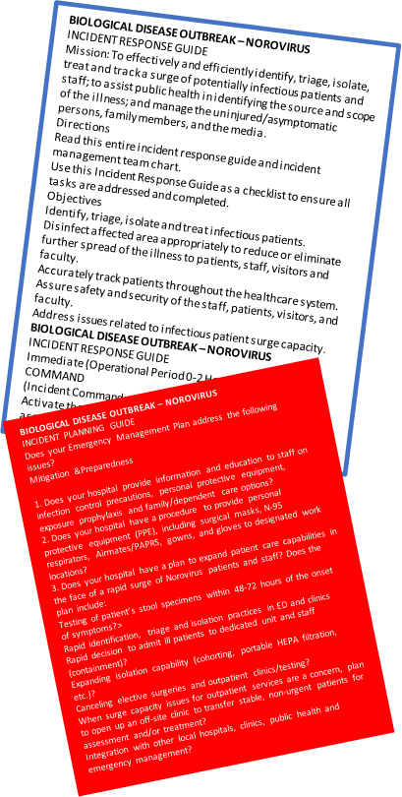
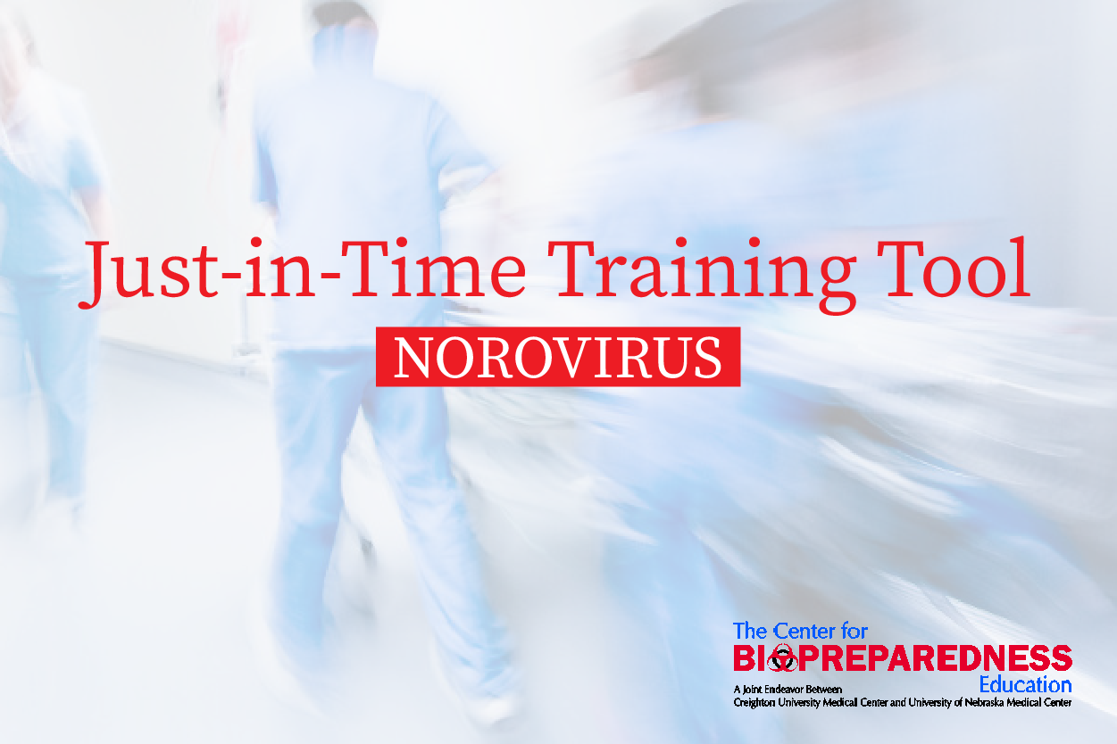




NOROVIRUS Just-in-Time training tool developed to improve response time and efficiency.
Norovirus Outbreak Made Easy?
Utilizing incident command tactics for infectious disease outbreak responses
PRESENTER:
Kristine Sanger, BS, MT (ASCP)
INTRO:
Norovirus outbreaks have the ability to result in a surge of communicable patients in healthcare settings.
Just-In-Time (JIT) training materials help prepare responders for various aspects and tasks involved during an infectious disease outbreak response.
METHODS:
Published Hospital Incident Command System (HICS) guides were used to develop just-in-time training materials tailored for norovirus.
RESULTS
A just-in-time training tool tailored for norovirus was developed, including:
  A scenario,
  An incident planning guide, and
  An incident response guide.
Take a picture to
download the full paper
Notes:
For the Norovirus JIT training tools referred to in the sample poster, click the links below.
Just in Time Training tool (https://cdn.ymaws.com/www.ahepp.org/resource/resmgr/poster/jitnoro2.pdf)
Incident Planning Guide (https://cdn.ymaws.com/www.ahepp.org/resource/resmgr/poster/noro2.pdf)
Incident Command Chart (https://cdn.ymaws.com/www.ahepp.org/resource/resmgr/poster/noro_chart_all.pdf)

Slide 2
Lessons Learned/Summary
A just-in-time training tool tailored for norovirus was developed, including:
                A scenario
                An incident planning guide
                An incident response guide
Questions? Reach out to your contact info here

